Slide 1

Customer Segmentation and Recommendation
Project Source - Kaggle
By Team
Bhaskar Patil
Raghuram Iyengar
Michael Gattone
Prakash Srivastava

Slide 2
Project Objectives
Explore retail transactional data, transform to customer-centric features, segment the customers and make campaign and product recommendations to increase the sales:
Data Exploration and Transformation
Feature Engineering – RFM Model
Dimensionality Reduction using PCA
Customer Segmentation using K-Means Clustering Algorithm.
Cluster Analysis and Evaluation
Campaign and Product Recommendations

Slide 3
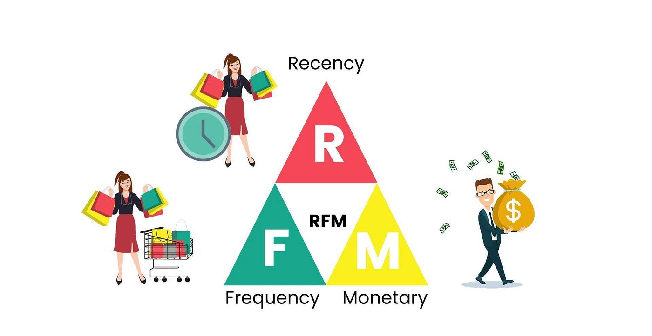
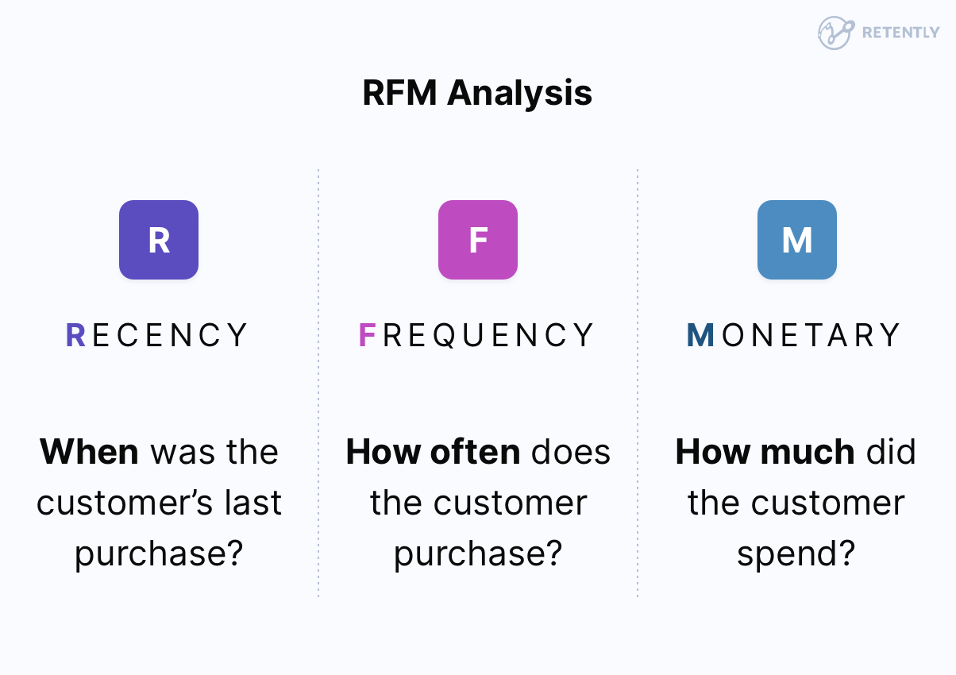
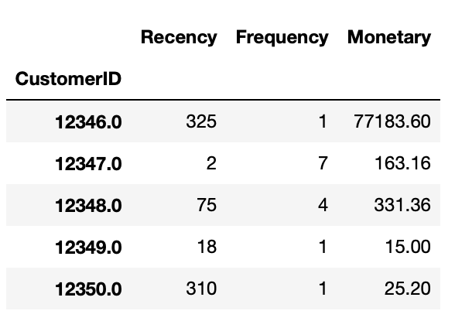
Feature Engineering - RFM

Slide 4
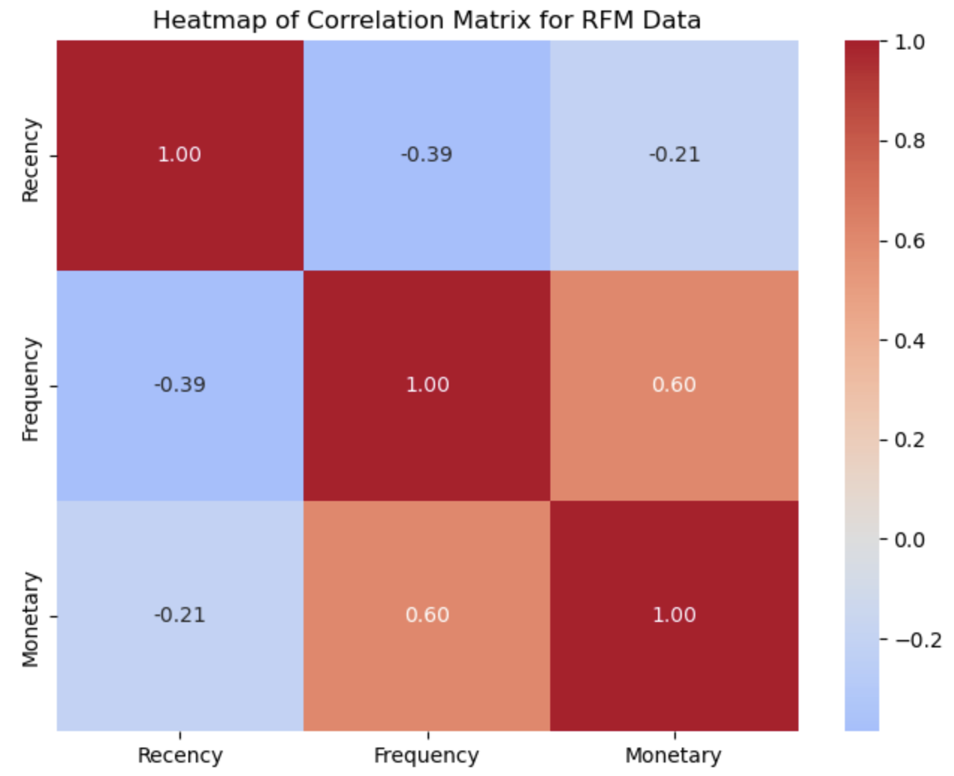
RFM Features - Correlation

Slide 5
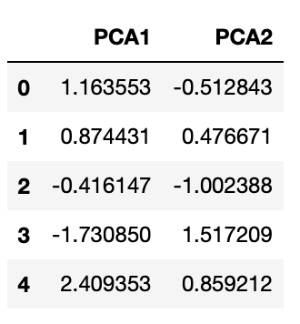
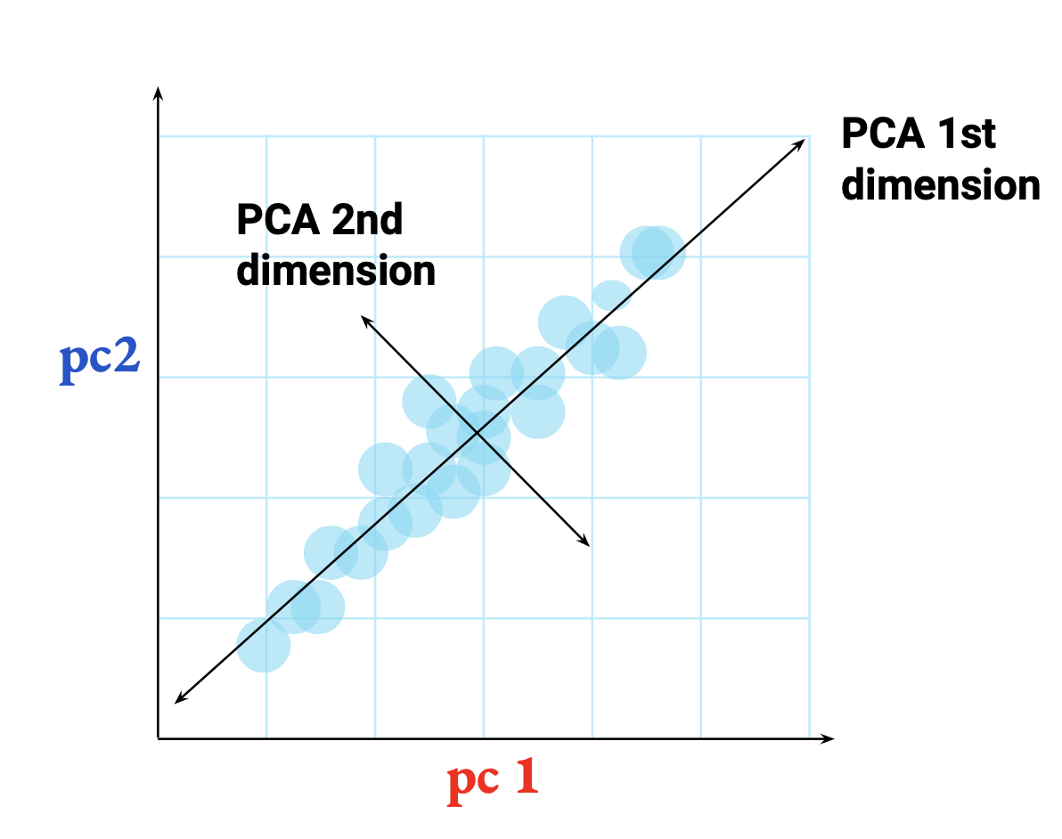
Dimensionality Reduction - PCA
pca = PCA(n_components=2)
pca.explained_variance_ratio_
array([0.60563992, 0.27198328])
87% variance captured with two components

Slide 6
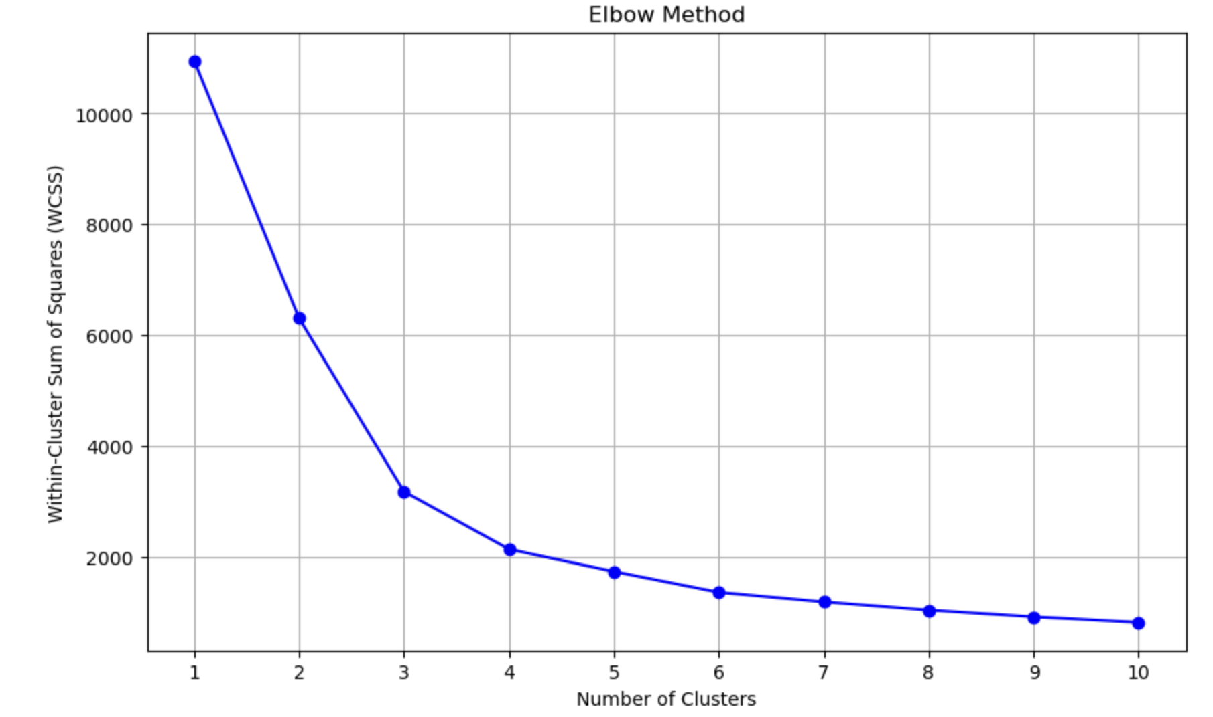
K-Means Optimal K

Slide 7
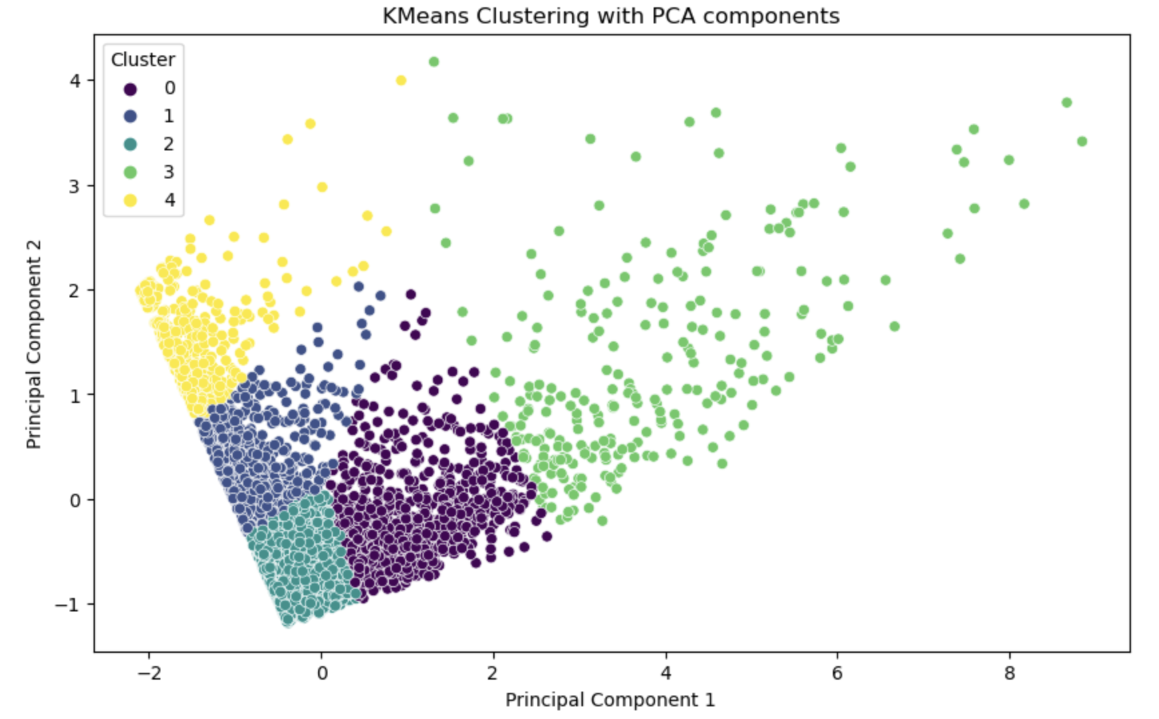
K-Means Clustering

Slide 8
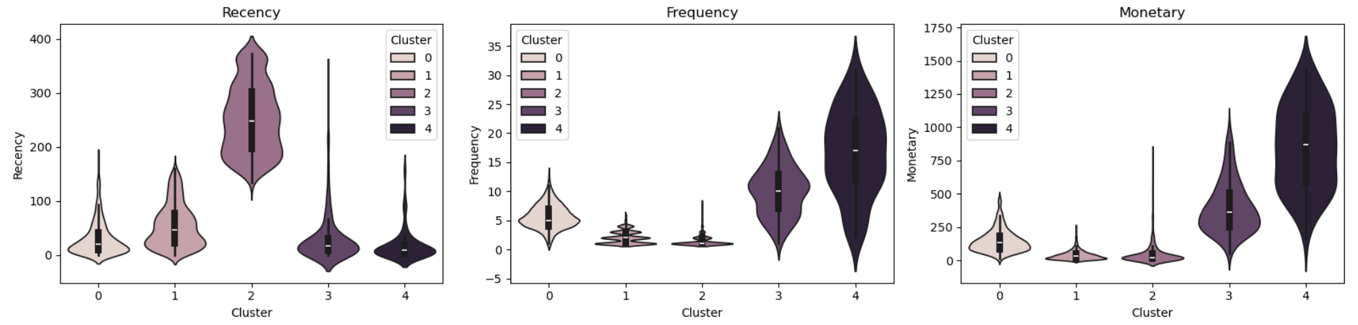
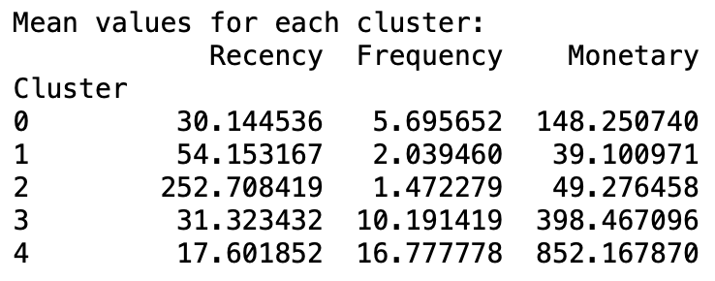
RFM Mean values among clusters

Slide 9
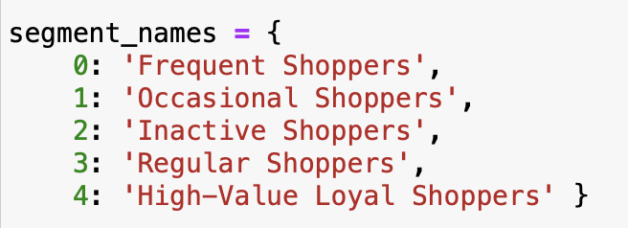
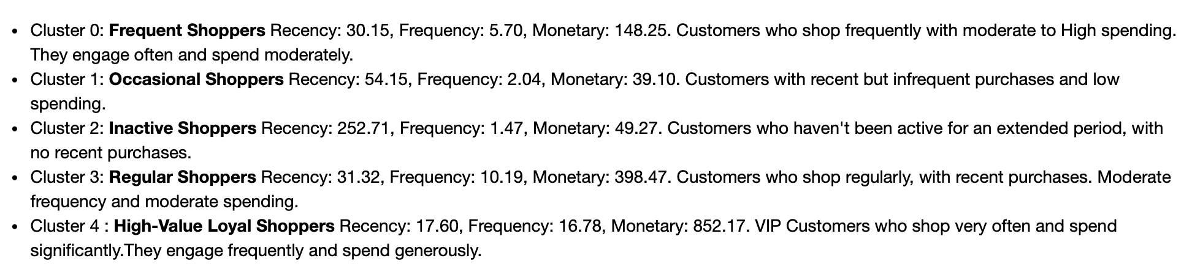
Segment Labels to Clusters

Slide 10
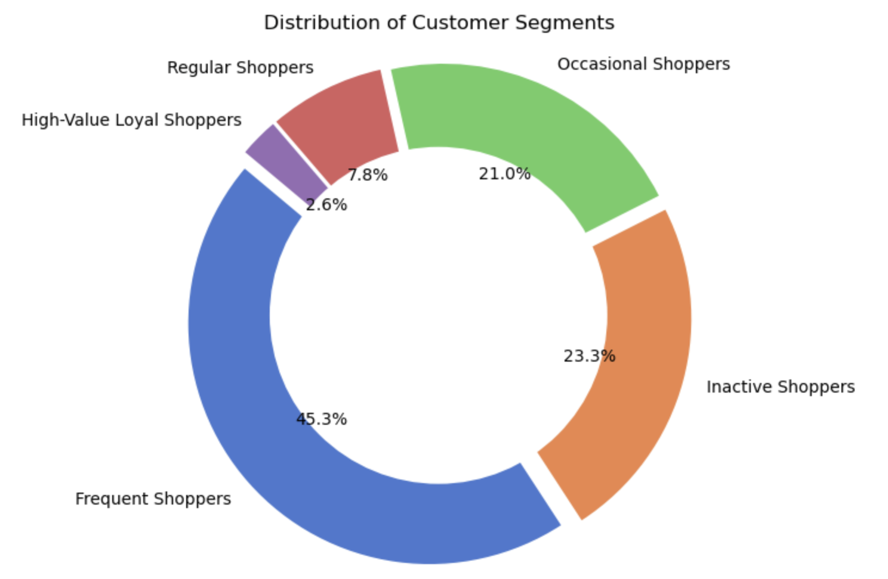
Segments Distribution

Slide 11
Campaign Recommendation
High Value/Loyal Customers: Offer personalized special discounts, early access, and other premium perks to make them feel valued and appreciated.
Frequent/Regular Customers: Appreciation campaigns, referral bonuses, and rewards for loyalty.
Occasional Customers: Re-engagement efforts that include running discounts or promotions to encourage buying.
Inactive Customers: Targeted campaigns educating them about the brand and discounts on subsequent purchases.

Slide 12
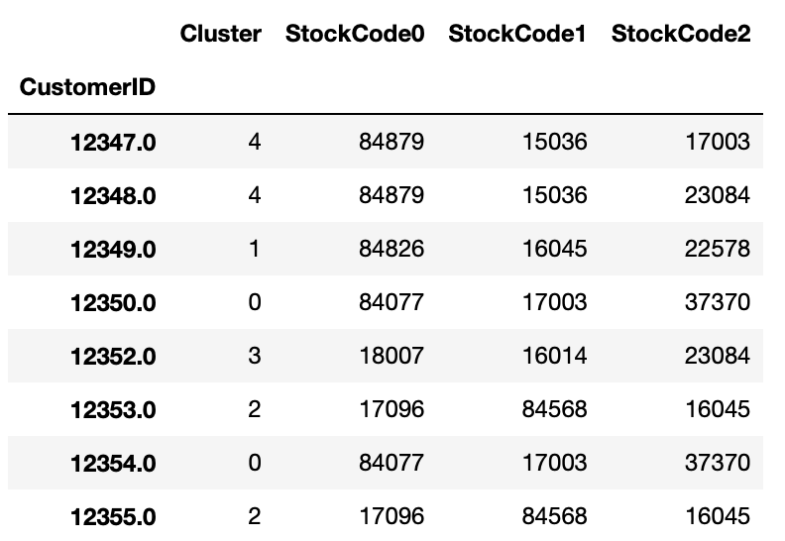
Products Recommendation – Top 3

Slide 13

Conclusion
Segmentation Benefits
Personalization: Segmentation allows businesses to tailor their marketing messages, product recommendations, and promotions to each customer group's specific needs and interests.
Improved Targeting: By identifying high-value and at-risk customers, businesses can allocate resources more efficiently, focusing efforts where they are most likely to yield results.
Customer Retention: Segmentation helps businesses create retention strategies by understanding what keeps customers engaged and satisfied.

